Slide 1

DAI Capstone
Would you like some fries with that?
Nicholas Leong

Slide 2
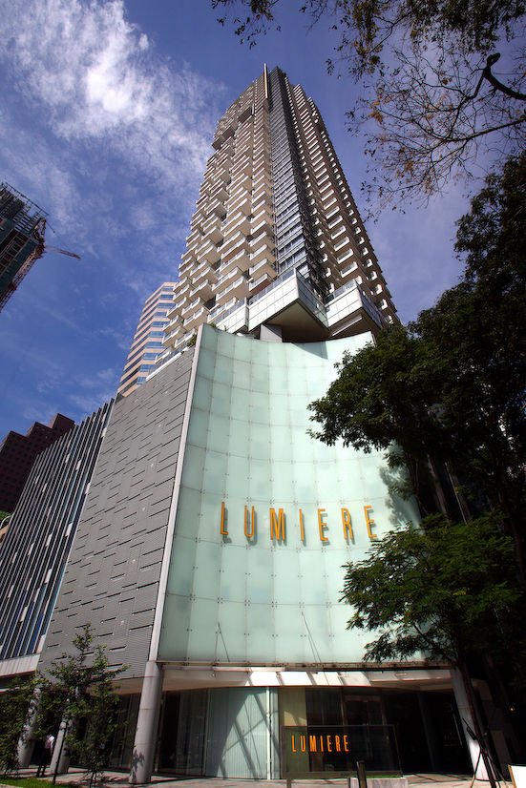
Problem Statement
As a F&B owner, is it possible to get a gauge on how I should price my products down to the exact location in Singapore?
Scenario:
A new Lor Mee owner wants to setup a stall at 2 Mistri Rd, Singapore 079624, Lumiere. How much should he or she price the Lor Mee at?
The simplest approach is to price it at a mark up rate e.g. 30%
Survey all the lor mee prices about X meters within the area
Take a look at the chicken rice stall next door and compare that to a nearby hawker stall with both chicken rice and lor mee
Random trial and error

Slide 3
Problem Statement
Current Method | Problems
Mark Up % | If priced too high, there can be loss of sales due to less customers If priced too low, we would also have a loss of revenue since we could have earned more
Compare to all Lor Mee around the area | Depending on the number of your samples taken, it might not be statistically accurate Your Lor Mee / Chicken Rice portions might not have the same ingredients / X Factor as the comparisons Sometimes you have nothing to compare to
Compute the Lor Mee : Chicken Rice ratio
Random Trial and Error | You take a long time to reach a local/global optimum You are constantly in “experimental” mode because environments change constantly
The market is not always perfectly efficient, why not consider a data driven approach and reap the benefits of inefficiency?

Slide 4
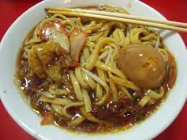
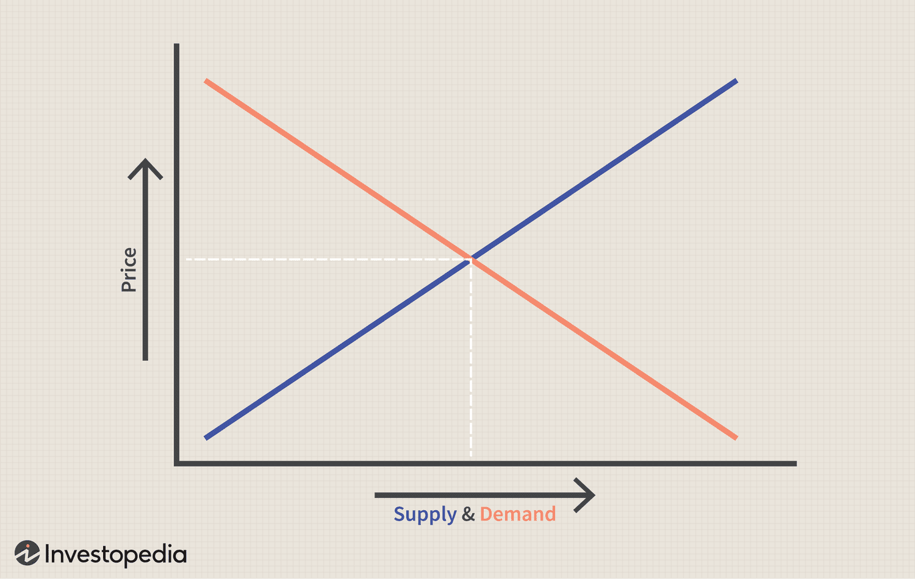
Data Driven Approach
Cost Factors
Ingredients
Rental
Salaries
Demand Factors
Number of customers
Income group of customers
Intangibles
Branding
Social Media Buzz
X Factor
We want to be as close to here as possible!

Slide 5
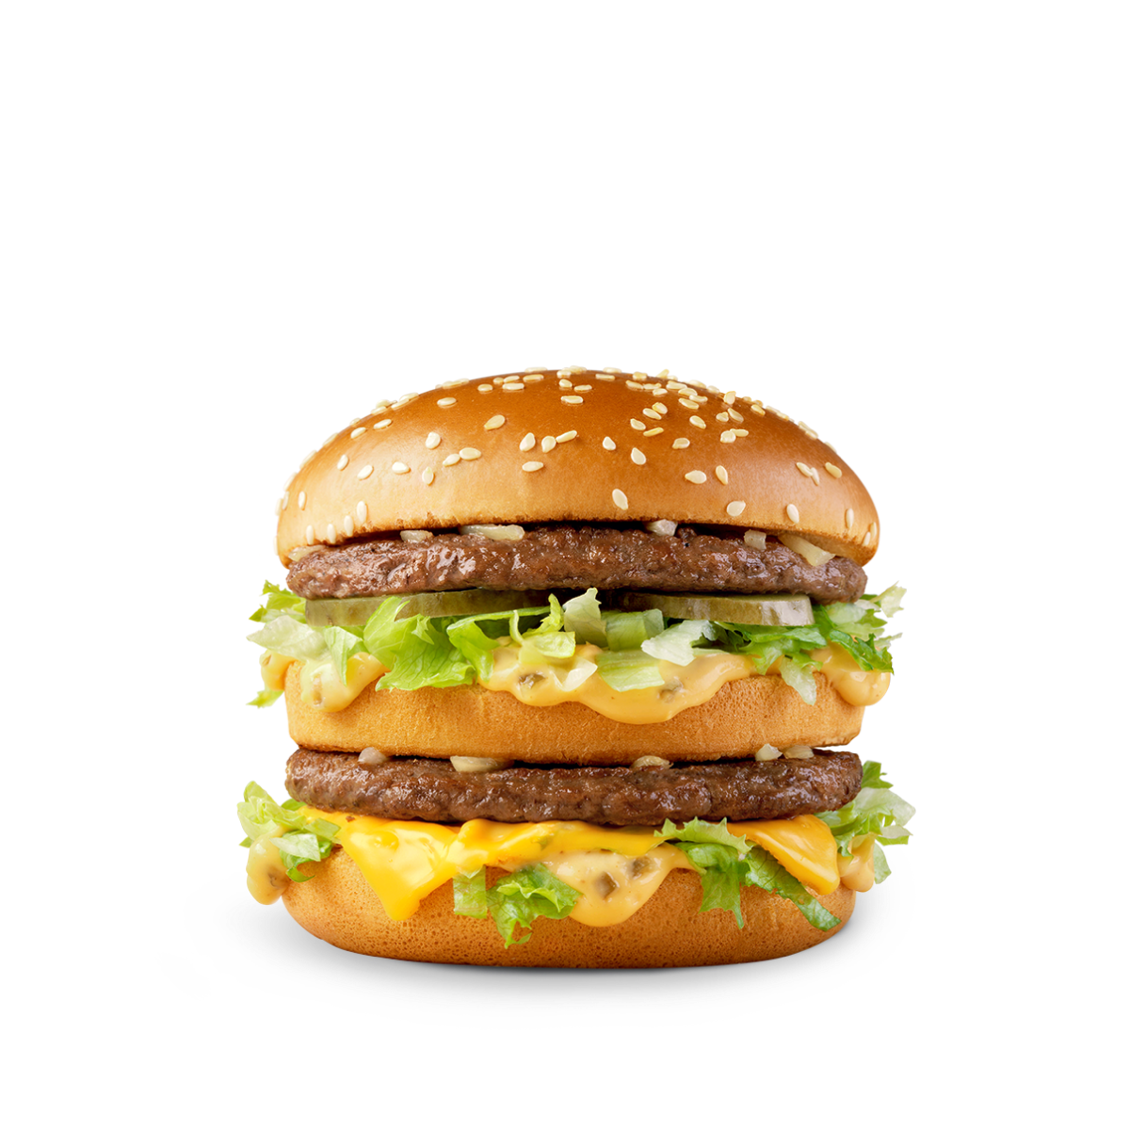
Data Driven Approach - Why McDonalds?
Cost Factors
Ingredients
Salaries
Rental
Demand Factors
Number of customers
Income group of customers
Intangibles
Branding
Social Media Buzz
X Factor
McDonalds menu actually has a price difference depending on where you buy it in Singapore-> An indication that it may be competitively priced
McDonalds has a huge presence in Singapore with 140+ stores thus providing a good coverage for scoping our work to Singapore. It also provides another indication that it is competitively priced
We can skip evaluating ambiguous data (Branding, X Factor) and internal data that we cannot get (Ingredients, Salaries) in the equation since all McDonalds are the same for these factors

Slide 6
Data Driven Approach - Why McDonalds?
Cost Factors
Ingredients
Salaries
Rental
Demand Factors
Number of customers
Income group of customers
Intangibles
Branding
Social Media Buzz
X Factor
McDonalds menu actually has a price difference depending on where you buy it in Singapore-> An indication that it may be competitively priced
McDonalds has a huge presence in Singapore with 140+ stores thus providing a good coverage for scoping our work to Singapore. It also provides another indication that it is competitively priced
We can skip evaluating ambiguous data (Branding, X Factor) and internal data that we cannot get (Ingredients, Salaries) in the equation since all McDonalds are the same for these factors

Slide 7
Data Driven Approach - Scalability
Cost Factors
Ingredients
Rental
Salaries
Demand Factors
Number of customers
Income group of customers
Intangibles
Branding
Social Media Buzz
X Factor
For any selected choice of F&B, if we assume that it follows McDonald’s solved equation, we can solve the pricing problem for any F&B by simply using McDonalds as a reference
For example, what is the cost of ingredients for Lor Mee vs a Big Mac?
Cost Factors
Ingredients
Salaries
Rental
Demand Factors
Number of customers
Income group of customers
Intangibles
Branding
Social Media Buzz
X Factor

Slide 8
Data Driven Approach - Project Scope
Cost Factors
Rental
Demand Factors
Number of customers
Income group of customers
We will only look at approximating McDonalds Prices in this project
Since some of the factors we discussed are universal across McDonalds, we can disregard them and use these below instead:
Factors | Possible features that approximate the factors
Rental Cost | Number of Public / Private buildings in the surrounding area of the McDonalds
Number of Customers | Population density of area of the McDonalds Passenger volume by bus stops in the surrounding area of the McDonalds
Income group of Customers | Type of flat in the surrounding area of the McDonalds

Slide 9
Data Driven Approach - Objectives
For each McDonalds location web scraped from Google Maps
Compute
Cost Factors
Rental
Demand Factors
Number of customers
Income group of customers
Regression / Classification Model
Competitive and Data Driven McDonalds Price

